Slide 1
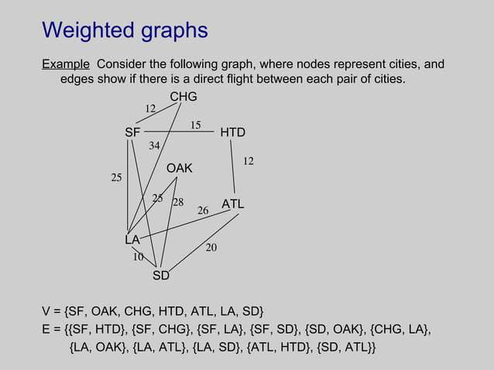

Slide 2
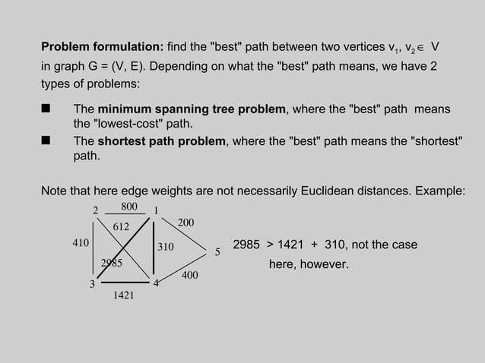

Slide 3
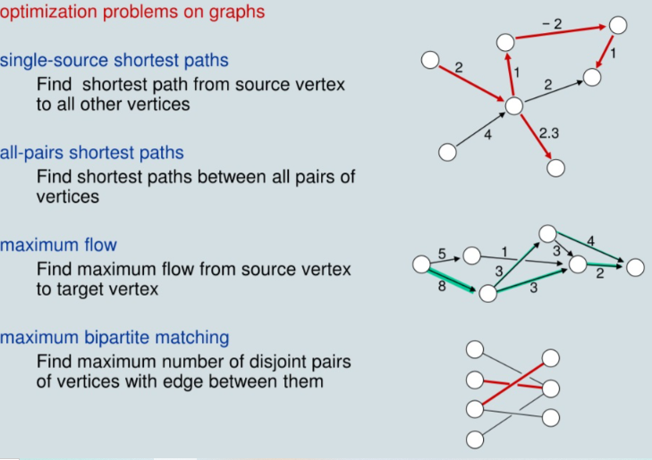

Slide 4
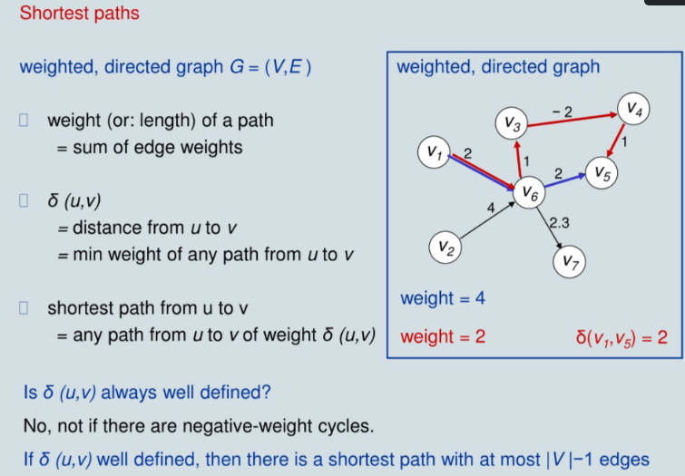

Slide 5
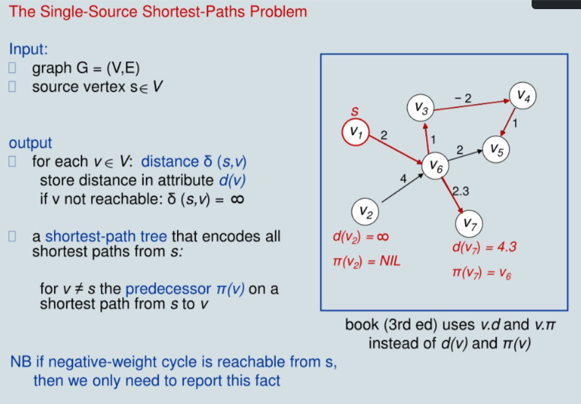

Slide 6
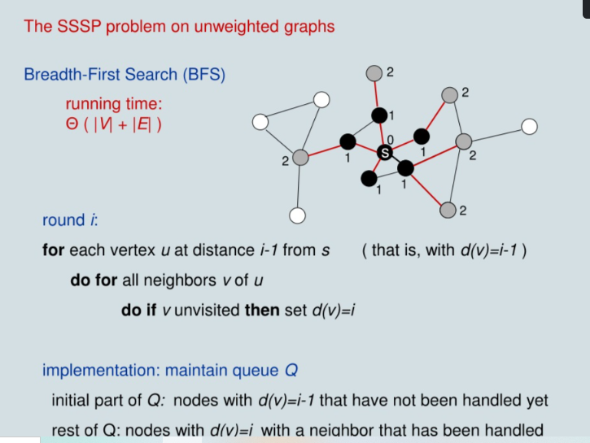

Slide 7


Slide 8
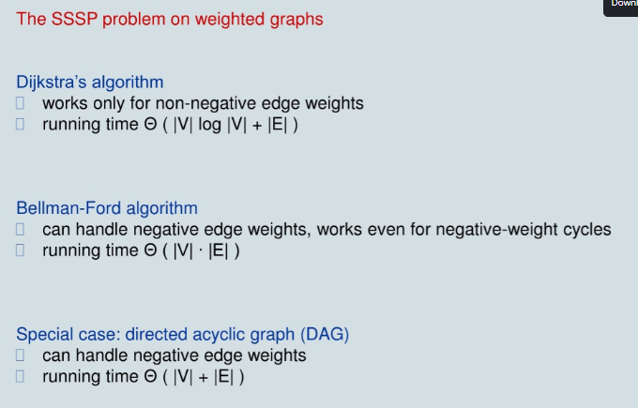

Slide 9
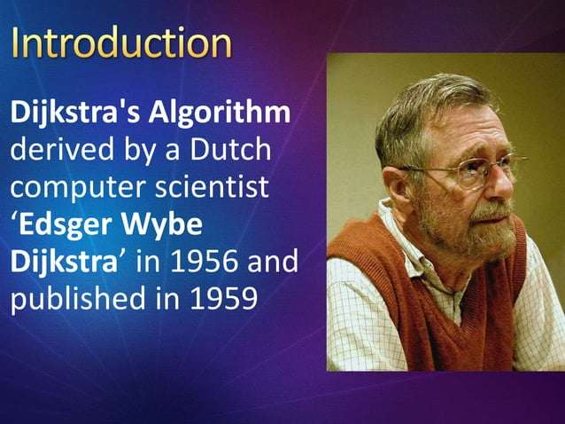

Slide 10
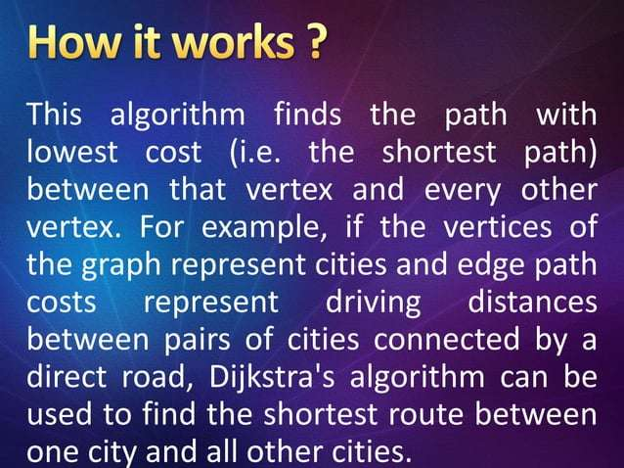

Slide 11
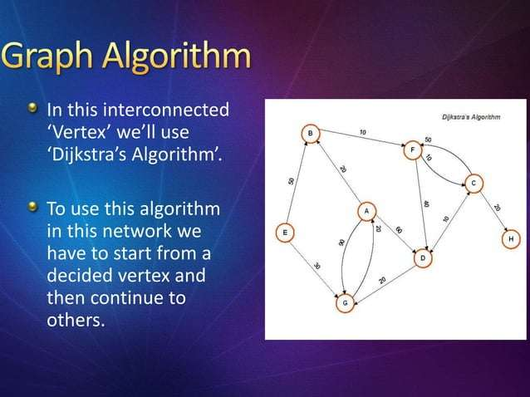

Slide 12
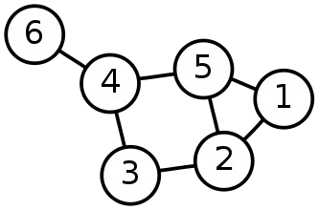
Single-Source Shortest Path Problem
Single-Source Shortest Path Problem - The problem of finding shortest paths from a source vertex v to all other vertices in the graph.

Slide 13
Dijkstra's algorithm
Dijkstra's algorithm - is a solution to the single-source shortest path problem in graph theory.
Works on both directed and undirected graphs. However, all edges must have nonnegative weights.
Approach: Greedy
Input: Weighted graph G={E,V} and source vertex v∈V, such that all edge weights are nonnegative
Output: Lengths of shortest paths (or the shortest paths themselves) from a given source vertex v∈V to all other vertices

Slide 14
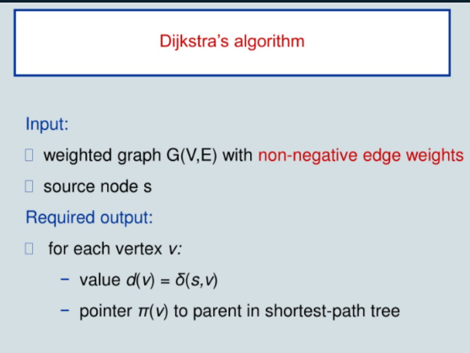

Slide 15
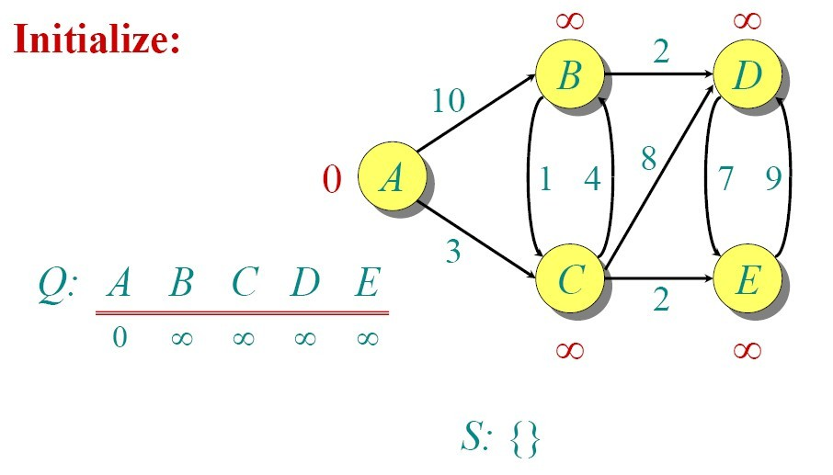
Dijkstra Animated Example

Slide 16
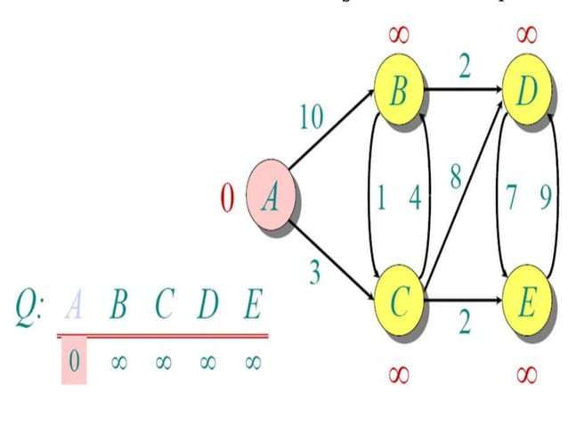

Slide 17
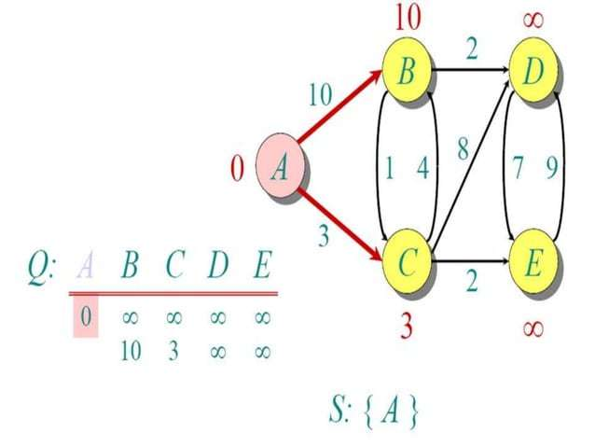

Slide 18
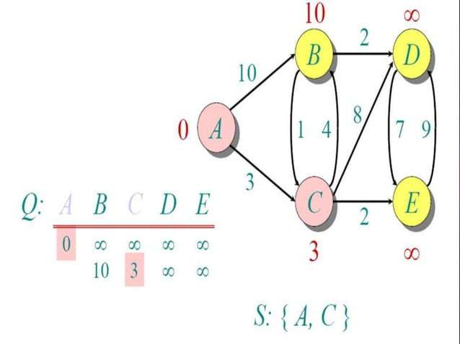

Slide 19
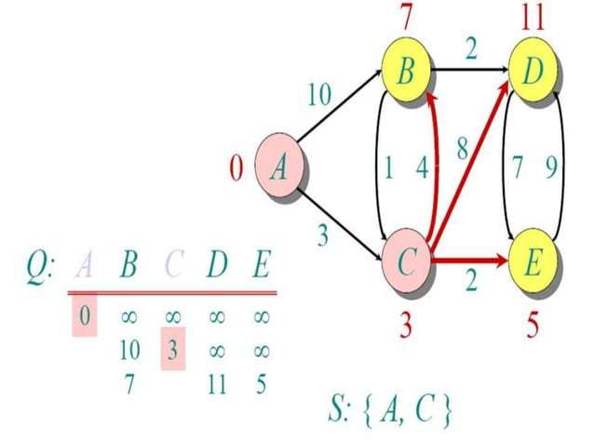

Slide 20
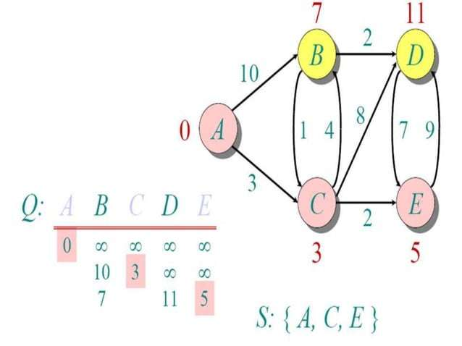

Slide 21
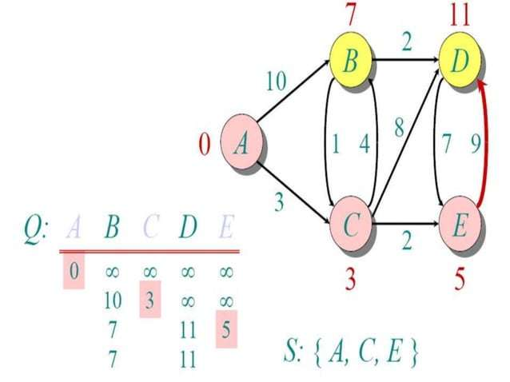

Slide 22
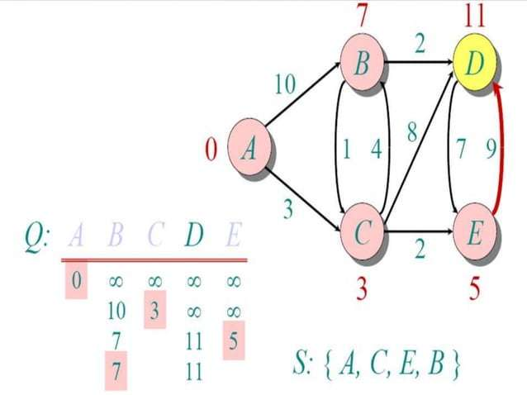

Slide 23
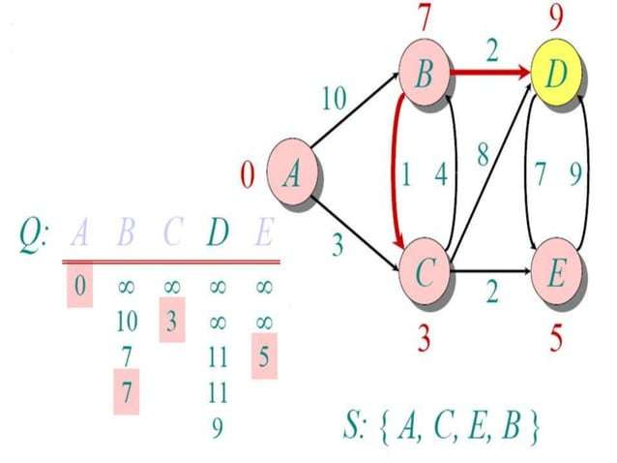

Slide 24
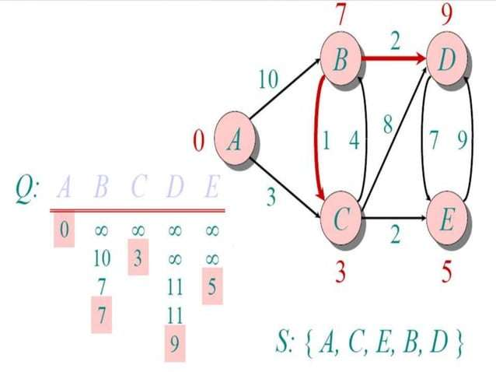

Slide 25
Dijkstra's algorithm - Pseudocode
dist[s] ←0
for all v ∈ V–{s}
do dist[v] ←∞
S←∅ Q←V
(distance to source vertex is zero)
(set all other distances to infinity)
(S, the set of visited vertices is initially empty) (Q, the queue initially contains all vertices)
while Q ≠∅
do u ← mindistance(Q,dist) S←S∪{u}
for all v ∈ neighbors[u]
(while the queue is not empty)
(select the element of Q with the min distance)
.
(add u to list of visited vertices)
do if dist[v] > dist[u] + w(u, v)
(if new shortest path found) (set new value of shortest path)
then d[v] ←d[u] + w(u, v)
(if desired, add traceback code)
return dist
https://www.youtube.com/watch?v=EFg3u_E6eHU

Slide 26
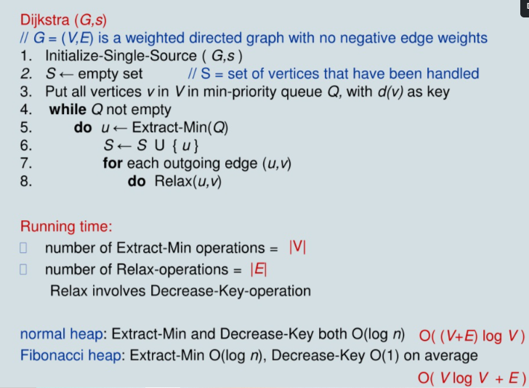

Slide 27
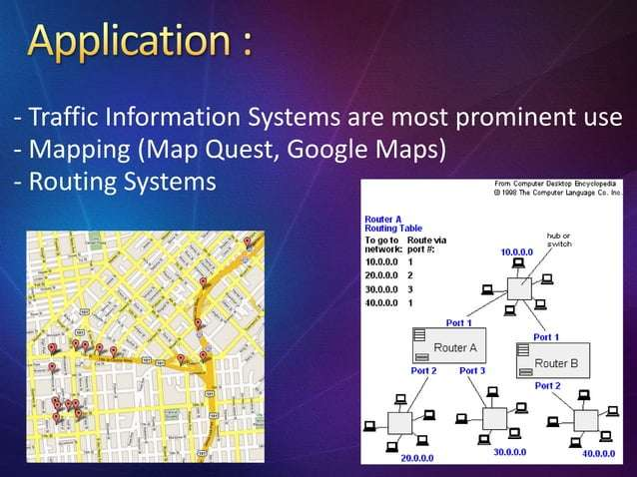

Slide 28
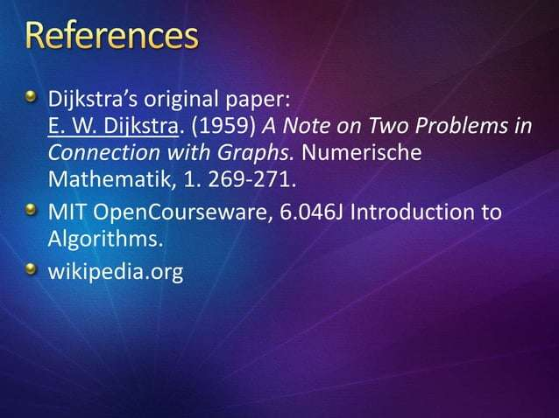

Slide 29


